Slide 1
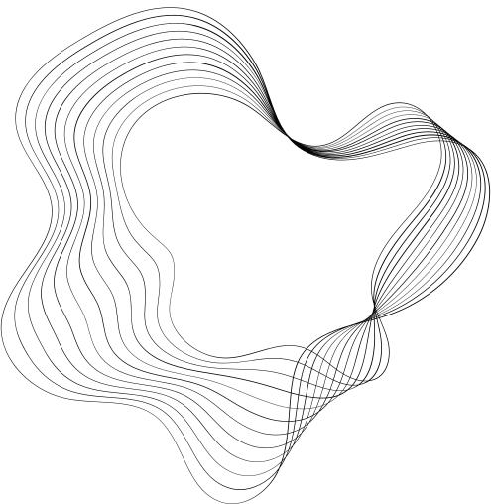


DEPARTMENT OF COMPUTER SCIENCE
PROJECT PRESENTATION (KCS 851)
SIGN LANGUAGE
RECOGNITION SYSTEM
Prof. Raj Kumar
(Assistant Professor &Addl. HOD)
PROJECT MEMBERS:-
Vidhi - 2000290120188
VISHAKHA RANA:- 2000290120192
Sanskriti Bajpai:- 2000290120135

Slide 2
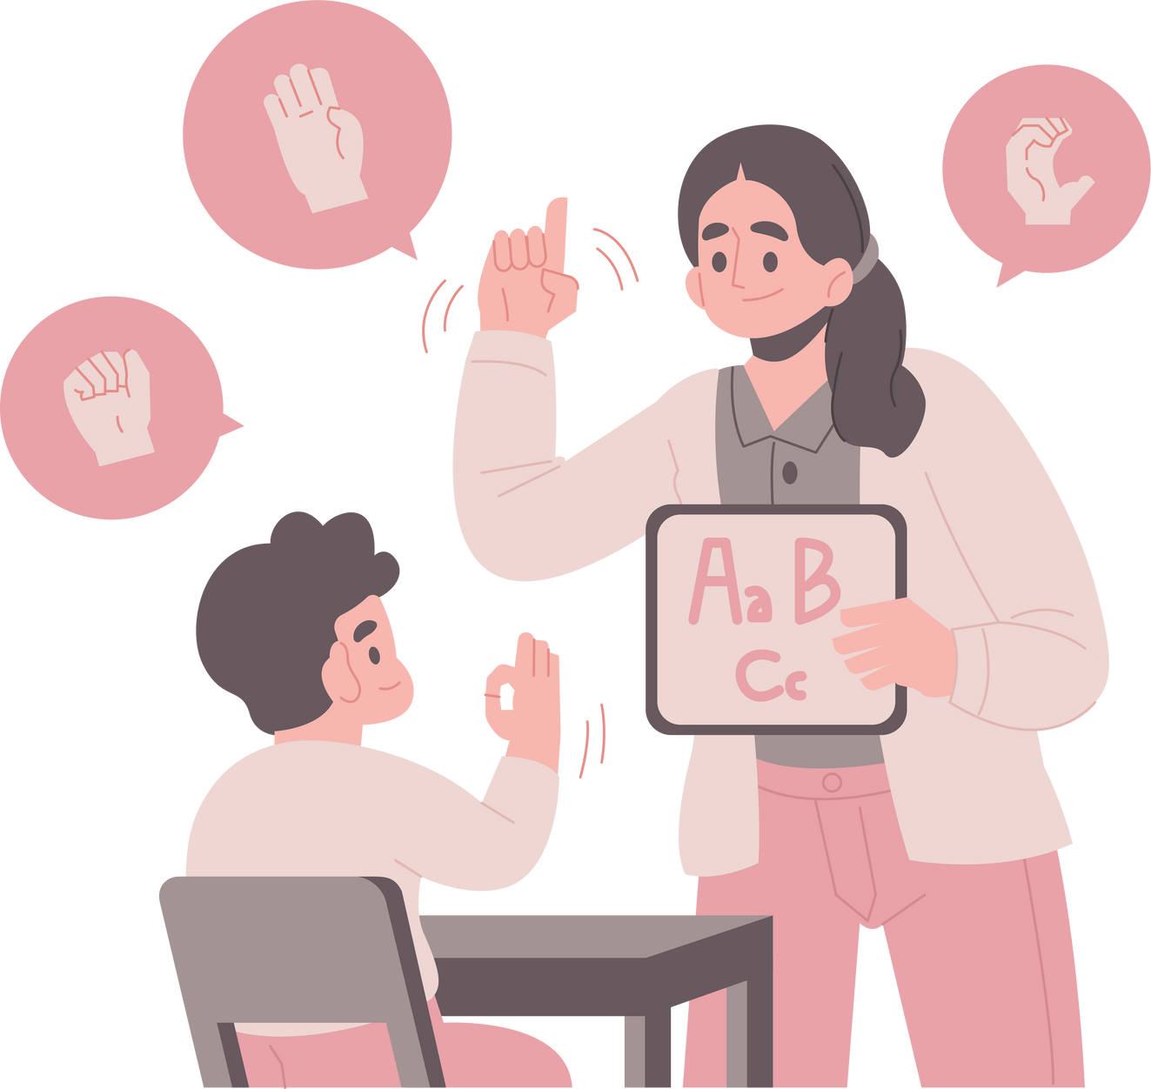


PROBLEM STATEMENT
Speech impaired people use hand signs and gestures to communicate. Normal people face difficulty in understanding their language as they don’t recognize the sign made by them ,this make a barrier.
Hence there is a need of a system which recognizes the different signs, gestures and conveys the information to the normal people. It bridges the gap between physically challenged people and normal people.

Slide 3





GOALS AND OBJECTIVES
Objective n° 1
Objective n° 2
Objective n° 3
The primary objective of the system is to facilitate communication and enable speech-impaired to communicate more effectively with those who do not understand sign language.
The project's core objective is to develop a robust sign language recognition system capable of accurately interpreting static hand gestures.
Another central objective is the conversion of recognized sign language gestures into spoken language. This involves initiating voice media through the system when the input image matches with the predefined dataset.

Slide 4

TECHNOLOGY USED
01
02
03
04
IMAGE RECOGNITION
OPEN CV
NUMPY
CNN
Image recognition is a mechanism used to identify an object within an image and to classify it in a specific category.
It is the huge open-source library for computer vision, machine learning, and image processing.By using it, one can process images and videos.
It is a library for the Python language, adding support for large collection of high-level mathematical functions to operate.
A convolutional neural network (CNN) is a type of artificial neural network used primarily for image recognition and processing, due to its ability to recognize patterns in images.

Slide 5

LITERATURE SURVEY
PAPER TITLE:-SIGN LANGUAGE RECOGNITION: STATE OF THE ART
AUTHOR NAME:-ASHOK SAHOO, GOURI MISHRA AND KIRAN KUMAR RAVULAKOLLU JOURNAL NAME:-ARPN JOURNAL OF ENGINEERING AND APPLIED SCIENCES YEAR OF PUBLISHING:-FEBRUARY 2014
Sign language is used by deaf and hard hearing people to exchange information between their own community and with other people. Computer recognition of sign language deals from sign gesture acquisition and continues till text/speech generation. Sign gestures can be classified as static and dynamic. However static gesture recognition is simpler than dynamic gesture recognition but both recognition systems are important to the human community. The sign language recognition steps are described in this survey. The data acquisition, data preprocessing and transformation, feature extraction, classification and results obtained are examined. Some future directions for research in this area also suggested.

Slide 6
LITERATURE SURVEY
PAPER TITLE:-SIGN LANGUAGE RECOGNITION
AUTHOR NAME:-KARAN BHAVSAR, RAJ GHATIYA, AARTI GOHIL, DEVANSHI
THAKKAR, BHUMI SHAH
YEAR OF PUBLISHING:-MAY 2021
Every day we see many people who are facing illness like deaf, dumb and blind etc. They face difficulty to interact with others. Previously developed techniques are all sensors based and they didn’t give the general solution. The major goal of the proposed project is to create a cost-effective system that uses Smart Gloves to provide voice to the silent. Using a flex sensor and a microprocessor, the suggested method converts sign language into text and speech. It means that communication between two communities will not be hampered by the use of smart gloves.

Slide 7
LITERATURE SURVEY
PAPER TITLE:-SIGN LANGUAGE RECOGNITION WITH UNSUPERVISED FEATURE LEARNING AUTHOR NAME:-JUSTIN CHEN, STANFORD UNIVERSITY
YEAR OF PUBLISHING:-AUGUST 2021
This paper focuses on experimenting with different segmentation approaches and unsupervised learning algorithms to create an accurate sign language recognition model. To more easily approach the problem and obtain reasonable results, we experimented with just up to 10 different classes/letters in the our self-made dataset instead of all 26 possible letters. We collected 12000 RGB images and their corresponding depth data using a Microsoft Kinect. Up to half of the data was fed into the autoencoder to extract features while the other half was used for testing. We achieved a classification accuracy of 98% on a randomly selected set of test data using our trained model. In addition to the work we did on static images, we also created a live demo version of the project which can be run at a little less than 2 seconds per frame to classify signed hand gestures from any person

Slide 8
LITERATURE SURVEY
PAPER TITLE:-SIGN LANGUAGE RECOGNITION
AUTHOR NAME:-SATWIK RAM KODANDARAM, N PAVAN KUMAR SUNIL G L
YEAR OF PUBLISHING:- AUGUST 2021
Sign Language is mainly used by deaf (hard hearing) and dumb people to exchange information between their own community and with other people. Sign Language Recognition (SLR) deals with recognizing the hand gestures acquisition and continues till text or speech is generated for corresponding hand gestures. Here hand gestures for sign language can be classified as static and dynamic.However, static hand gesture recognition is simpler than dynamic hand gesture recognition, but both recognition is important to the human community.Once the model Successfully recognizes the gesture the corresponding English text is generated and then text can be converted to speech.This model will be more efficient and hence communicate for the deaf (hard hearing) and dump people will beeasier. In this paper, they discussed how Sign Language Recognition is done using Deep Learning.

Slide 9
LITERATURE SURVEY
PAPER TITLE:-SIGN LANGUAGE RECOGNITION SYSTEMS: A DECADE SYSTEMATIC LITERATURE REVIEW
AUTHOR NAME:-PARTEEK BHATIA AND ANKITA WADHAWAN
YEAR OF PUBLISHING:-JANUARY 2019
Despite the importance of sign language recognition systems, there is a lack of a Systematic Literature Review and a classification scheme for it. This is the first identifiable academic literature review of sign language recognition systems. It provides an academic database of literature between the duration of 2007–2017 and proposes a classification scheme to classify the research articles. One hundred and seventeen research articles were subsequently selected, reviewed and classified. The Systematic Literature Review and classification process was verified independently. Literature findings of this paper indicate that the major research on sign language recognition has been performed on static, isolated and single handed signs using camera. Overall, it was hoped that the study may provide readers and researchers a roadmap to guide future research and facilitate knowledge accumulation and creation in the field of sign language recognition.

Slide 10
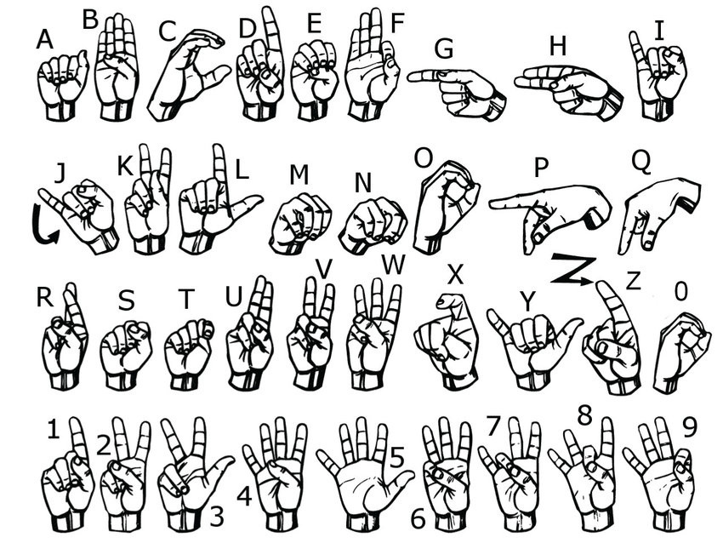
AMERICAN SIGN LANGUAGE

Slide 11
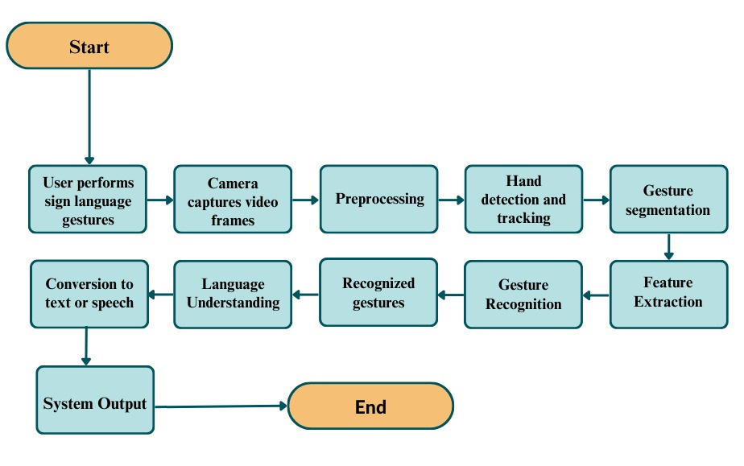
WORK FLOW DIAGRAM

Slide 12
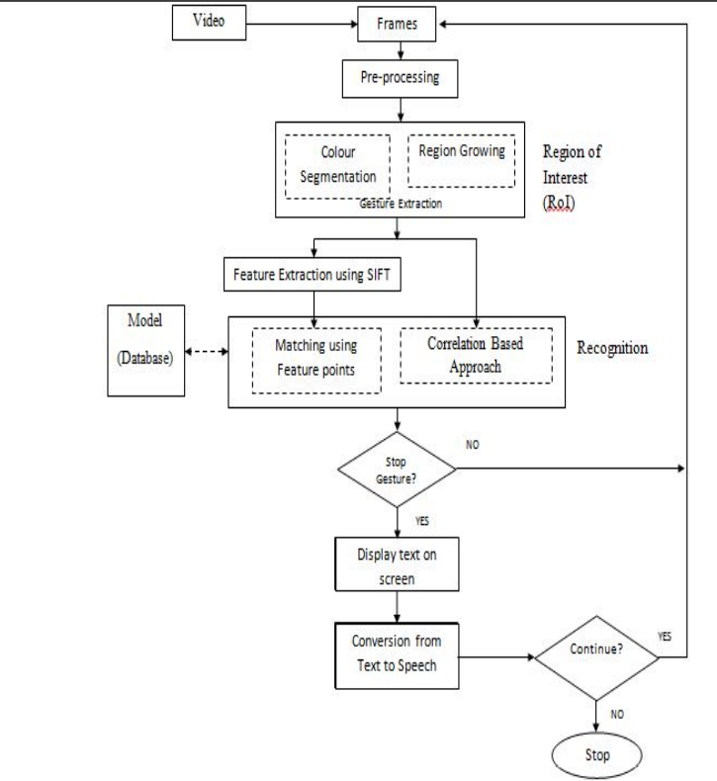
WORK FLOW DIAGRAM

Slide 13
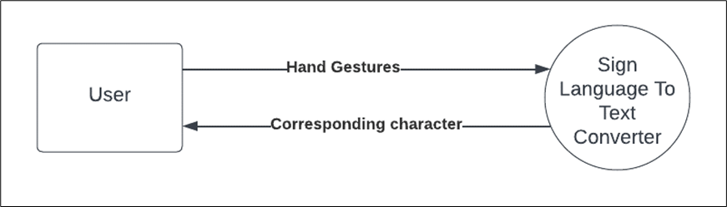
DATA FLOW DIAGRAMS
DFD LEVEL 0

Slide 14
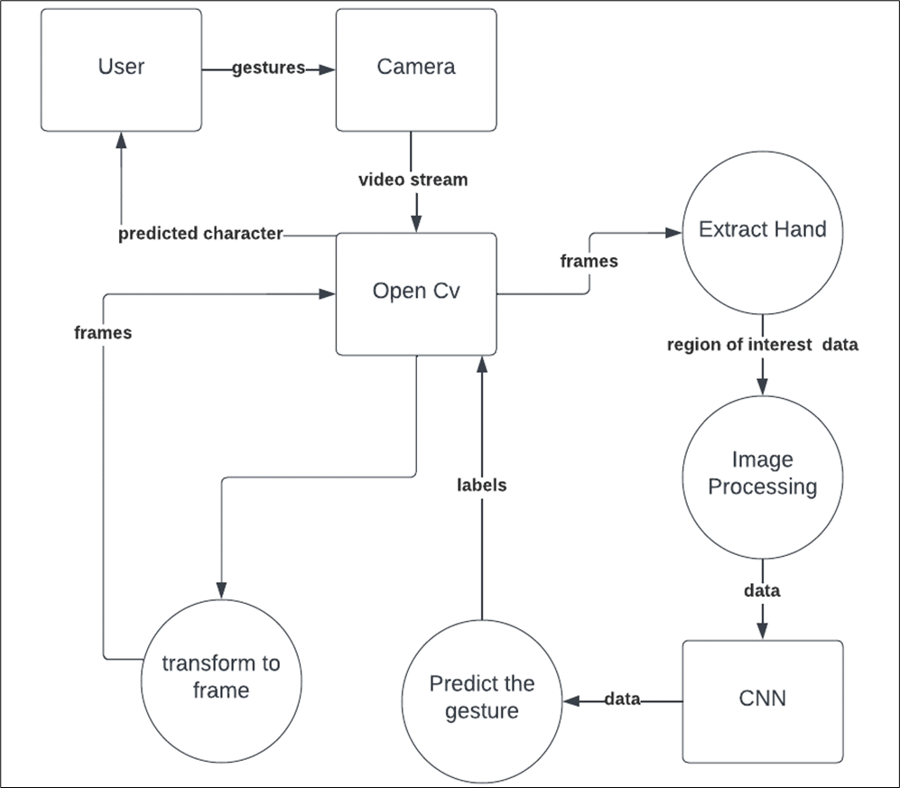
DATA FLOW DIAGRAMS
DFD LEVEL 1

Slide 15
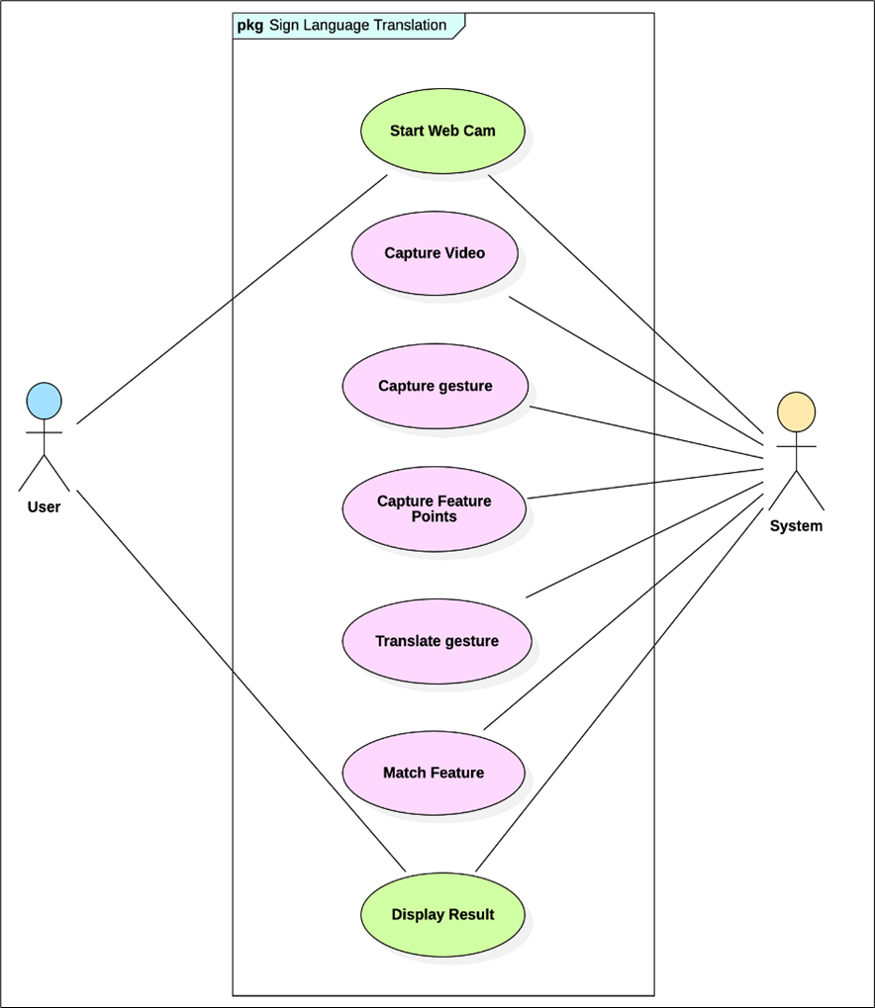
USE CASE DIAGRAM

Slide 16
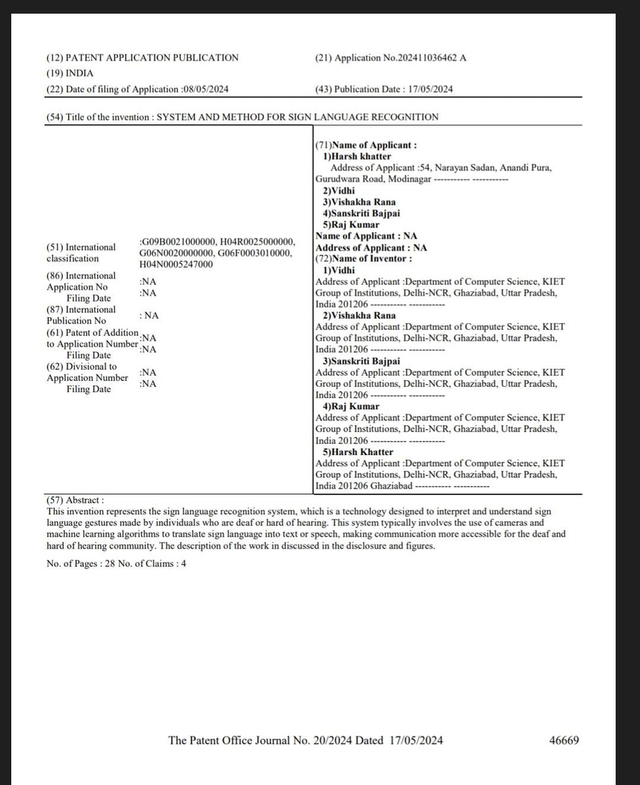
PATENT STATUS
PROOF OF PUBLICATION:
Patent has been published
Title:- System And Method For Sign Language Recognition
Application No.: 202411036462
Journal No.: 20/2024
Publication Date: 17/05/2024

Slide 17
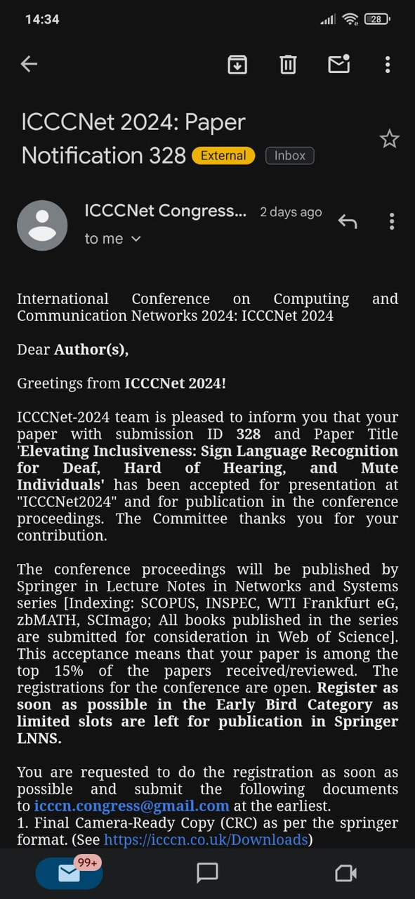
RESEARCH PAPER STATUS
PROOF OF ACCEPTANCE:
Research paper has been accepted in the ICCCNet 2024
Conference details:
4th International Conference on Computing and Communication Networks(ICCCNet-2024)
Springer LNNS Approved Conference (Indexed in Scopus, EI, WoS and Many More)
Conference Link: https://icccn.co.uk/
Hyperlink of Paper:
https://1drv.ms/w/s!AiAjZfcuCwFGgVDVdI2k8JtoiSWg

Slide 18
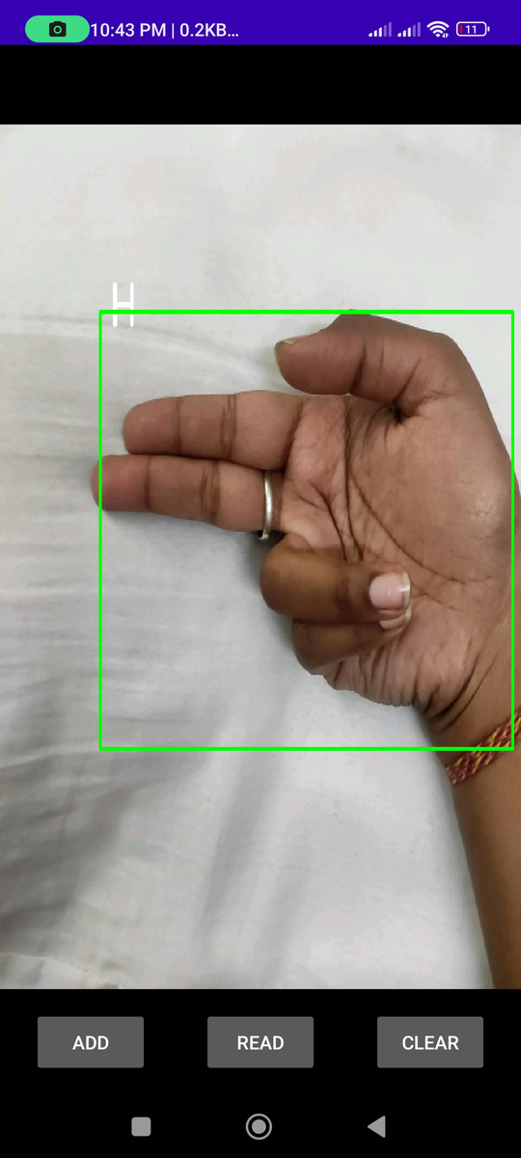
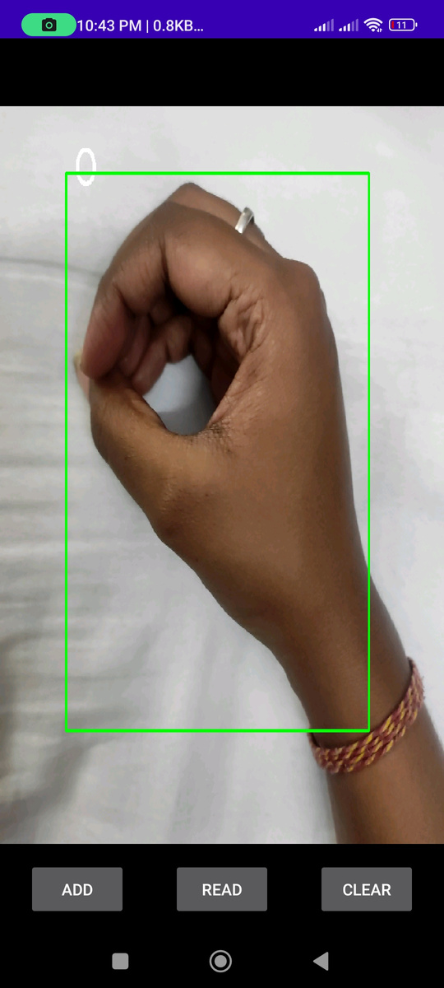
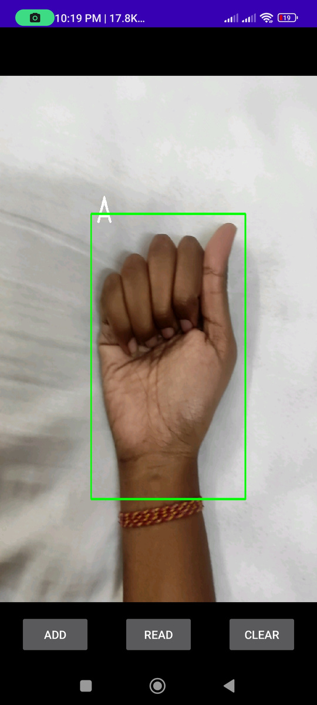
PROJECT STATUS
Project is 100% completed

Slide 19
PROOF FOR ALL DOCUMENTS
Hyperlink for Testing Report:
https://docs.google.com/document/d/1bXzt_ppmtMlkXMj62ogjo28gwr-HfijpKpURtN23FJQ/edit?usp=sharing
Hyperlink for SRS:
https://docs.google.com/document/d/12kIqCdZQlsBS9j1cnh8s2d2Wdx0erunaiIGI-QAwuLo/edit?usp=sharing
Hyperlink for Synopsis
https://1drv.ms/w/s!AiAjZfcuCwFGgVDVdI2k8JtoiSWg
Hyperlink for Report
https://1drv.ms/w/s!AiAjZfcuCwFGgVDVdI2k8JtoiSWg

Slide 20
REFERENCES
1.HTTPS://WWW.IJERT.ORG/A-REVIEW-PAPER-ON-SIGN-LANGUAGE-RECOGNITION-FOR-THE-DEAF-AND-DUMB
2.http://vision.stanford.edu/teaching/cs231a_autumn1213_internal/project/final/writeup/distributable/Chen_Paper.pdf
3.https://research.ijais.org/icwac/number2/icwac1320.pdf
4.https://ijrpr.com/uploads/V2ISSUE9/IJRPR1329.pdf
5.https://www.researchgate.net/publication/262187093_Sign_language_recognition_State_of_the_ar
6.https://sci-hub.se/https://ieeexplore.ieee.org/document/7267912. 7.https://www.researchgate.net/publication/337990440_Sign_Language_Recognition_Systems_A_Decade_Systematic_Literature_Review
8.https://www.irjet.net/archives/V7/i3/IRJET-V7I3418.pdf

